Slide 1

TRAFFIC MANAGEMENT SYSTEM
EasyTraffic
Submitted By
Aakriti Singh 1900290120002
Aditi Dubey 1900290120007
Anurag Shukla 1900290120020
Under the Supervision of
Mr. Abhishek Goyal

Slide 2
Contents
Introduction​
Objectives
Outcomes/Area Of Focus
App Information
Timeline
​Conclusions

Slide 3
Have you ever been stuck in a traffic jam for hours ?
The average Mumbai resident wastes the equivalent of 8 days and 17 hours a year stuck in traffic jams.
The average Delhi resident spends 7 days and 22 hours, according to TomTom’s 2019 report.
According to Lancet’s report in 2019 , almost 1.6 Million people died due to Air Pollution in India.

Slide 4





objectives
study
analyze
app
Web app
Research paper
The impact of traffic jams and congestion on the road
The impact of pollution caused due to traffic congestion.
To allow users to register their traffic complaints.
Monitors these complaints for administration purposes
Effect of traffic congestion on environment.
Project Outcome

Slide 5
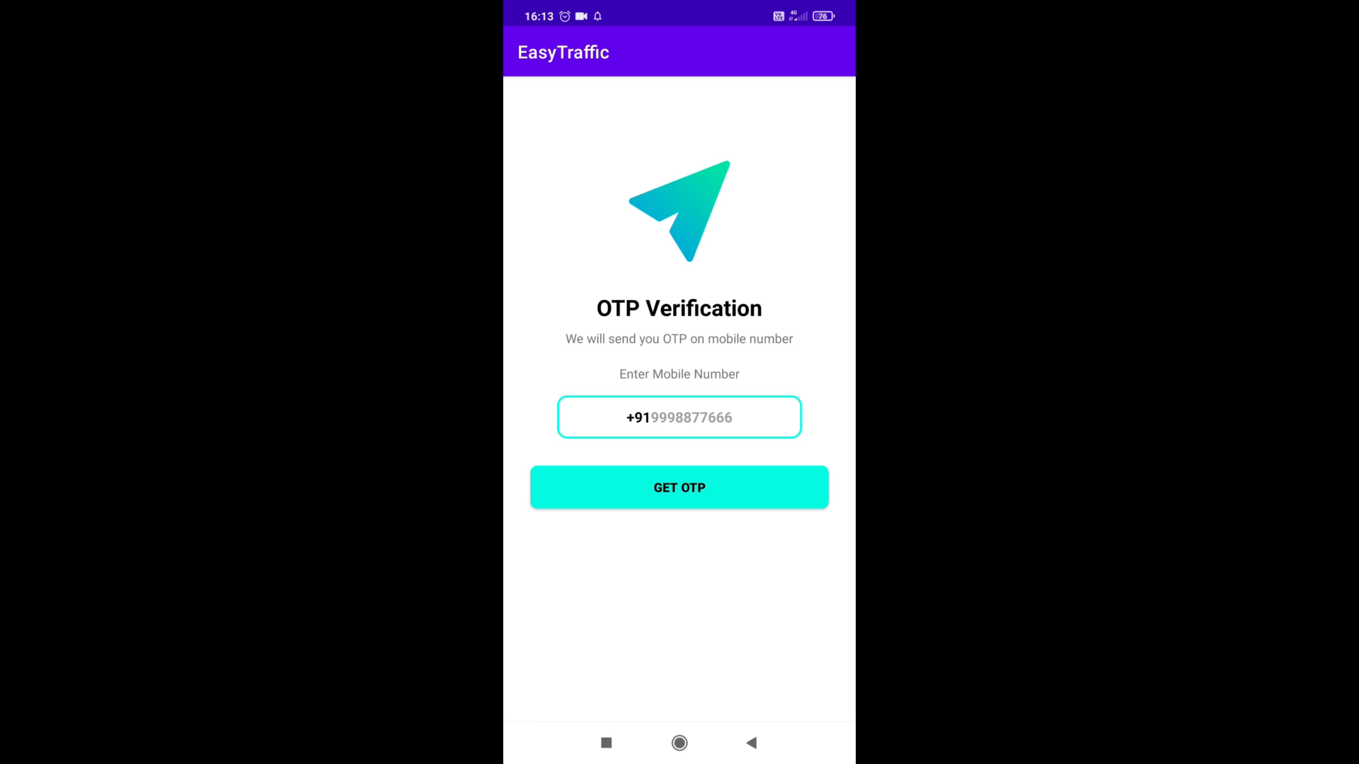
TECHNOLOGIES USED IN THE PROJECT
Android Development
React.js
Firebase (Cloud Database)
Google Maps APIs
Figma

Slide 6



Methodology - app
Client side
Admin side
Police booths
The clients who are stuck in the traffic can login in the app.
Then they can share their location and image as a proof.
This location data and image will be accessed by the control room.
The control room will verify this data.
If the complaint is right , the control room can redirect the nearest traffic police booth for help.
After getting the instruction , the nearest traffic police booths can reach the location and can take necessary actions.

Slide 7
AREAS OF FOCUS
Mobile app
research paper (Project Outcome)
We have taken this as a problem that can be solved with technology.
The apps will be developed using Android Studio.
App will connect customer to server of Traffic Control System.
Google APIs will be used to share current location of user.
Server will contact nearest Traffic Control Booth.
Controller will send the nearest help.
Increase in traffic congestion leads to emission of harmful gases into the environment.
This severely contributes to the pollution.
Therefore, we will collect data on pollution from the IMD (Indian Meteorological Department) website and analyze the data using machine learning to study the impact of traffic congestion on pollution

Slide 8
TIMELINE
Dec 2021
Feb 2022
MAR 2022
may 2022
Aug 2022
Worked on feasibility report.
Prioritized Requirements.
Started working on client side app.
Started working on admin side app.
Currently working on admin side dashboard.

Slide 9
SUMMARY
The project aims to eliminate the drawback of the existing traffic management system during road congestions causing harm to environment.
This project will help in efficient management of traffic on roads across the city. Commuters will be able to inform about traffic jams.
The location of the site will be accurately available to the traffic police hence the help will reach in shortest possible time.
The project titled “Traffic Management System” will prove out to be beneficial and efficient for commuters , management and environment.

Slide 10
MEET OUR TEAM
Aditi dubey
Aakriti singh
Anurag shukla
Client Side App
Admin Side App
Admin Side Dashboard (Web)

Slide 11
THANK YOU
Any Questions ?

